Slide 1
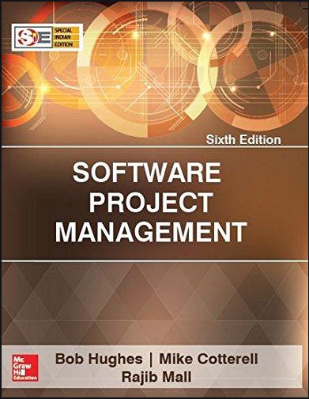
Software Project Management
6th Edition
Chapter 3
Project Evaluation
Project Management Institute

Slide 2
Objectives – Lecture 5
Introduction
Business case
Project portfolio management
Evaluation of Individual Projects
Cost benefit evaluation techniques
Project Evaluation
Strategic Assessment
Technical Assessment
Economic Assessment
Cost-Benefit Analysis
Cash Flow Forecasting

Slide 3
Introduction
A business case may be presented for several potential projects but there may be money, staff or time for only some of the projects. Managers need some way of deciding which projects to select. This is part of portfolio management. This chapter will discuss some ways in which projects can be evaluated and compared for inclusion in a project portfolio.
Managers need some way of deciding which projects to select.
This chapter will discuss some ways in which projects can be evaluated and compared for selection.

Slide 4
Business case
The objective of business case is to provide a justification for the project by showing that the benefits of the project will exceed the costs of development, implementation and operation.

Slide 5
Business case
A typical business case contain
Introduction and background to the proposal
The proposed project
The market
Organizational and operational infrastructure
The benefits
Outline implementation plan
Costs
The financial case
Risks
Management plan
Notes:
Market : Identifies the target market, market size, trends, and customer demographics. It also evaluates the market demand for the product or service.
The business case may identify external factors (such as technological changes, market trends, or regulatory shifts) that require organizational and operational adjustments.
Benefits : Quantifies potential revenue increases, cost savings, or profit growth, allowing stakeholders to see the projected return on investment (ROI).Details both costs and benefits clearly, building trust with investors, executives, and other stakeholders by showing the expected impact and potential risks.
Implementation Plan : Marketing,Promotions, outsourced vs in house activities,
Costs related to planned operations, expected as requirements are to be cleared
financial case ways to analyze the information of income and costs
Risks : relating to factors that threats to the benefits of delieverd projects
Management Plan : task allocation, key decision and milestones, number of projects managed under program

Slide 6
Project Portfolio Management
Project portfolio provides an overview of all the projects that an organization is undertaking or considering.
It prioritizes the allocation of resources to projects and decides which new projects should be accepted and which should be dropped.
Notes:
A project portfolio is a centralized collection of projects and programs managed and coordinated to achieve strategic business objectives.
New Product Development (NPD) projects involve the entire process of bringing a new product or service from concept to market. These projects are essential for companies looking to innovate, meet customer demands, and stay competitive. NPD typically requires cross-functional collaboration across R&D, marketing, finance, and production, and involves several key stages to minimize risk and increase the chance of success.
Renewal Projects focus on revitalizing, improving, or updating existing products, services, processes, or infrastructure within an organization. Unlike new product development, which aims to bring entirely new offerings to market, renewal projects aim to extend the lifecycle, relevance, and competitiveness of current assets. These projects are critical for maintaining customer satisfaction, operational efficiency, and long-term business sustainability.

Slide 7
Project Portfolio Management
The concerns of project portfolio management include
Identifying which project proposals are worth implementation.
Assessing the amount of risk of failure that a potential project has.
Deciding how to share limited resources.
Ensuring that projects do not duplicate work.
Notes:
Project Portfolio Optimization (PPO) is the process of selecting and managing a set of projects to maximize the overall value for an organization, while aligning with strategic objectives, balancing risks, and efficiently utilizing resources. By carefully evaluating and prioritizing projects, organizations can ensure that they invest in initiatives that provide the highest returns, meet strategic goals, and are feasible within resource constraints.

Slide 8
Evaluation of Individual Projects
Technical Assessment
Cost-Benefit Analysis
Cash Flow Forecasting
Strategic Assesment
Notes:
Why evaluate?

Slide 9
Strategic Assessment - SA
Not all projects can be assessed on some numeric values like quantified costs or benefits rather an assessment based on fulfillment of strategic objectives when combined with other projects, can also take place.
Programme Management: is defines as follows
‘a group of projects that are managed in a co-ordinated way to gain benefits that would not be possible were the projects to be managed independently’ Ferns.
“a collection of projects that all contribute to the same overall organizational goal”
Programmes may be.
Strategic
Business cycle programmes
Infrastructure programmes
Research and development programmes
Innovative partnerships
Notes:
Thus a project to establish an ICT infrastructure in an organization might not deliver direct financial benefit but could provide a platform for subsequent projects to do so.
It might not be possible to measure the benefits in financial terms. If you create system which allows the more accurate recording of data concerning medical condition of patients, it might contribute to the alleviation of pain and preservation of life, but would be difficult to put money value on this.
Strategic: Several projects together implement a single strategy. For example, merging two organizations will involve many different activities e.g. physical re-organization of offices, redesigning the corporate image, merging ICT systems etc. Each of these activities could be project within an overarching programme.
Business cycle programmes: A portfolio of project that are to take place within a certain time frame e.g. the next financial year
Infrastructure programmes: In an organization there may be many different ICT-based applications which share the same hardware/software infrastructure
Research and development programmes: In a very innovative environment where new products are being developed, a range of products could be developed some of which are very speculative and high-risk but potentially very profitable and some will have a lower risk but will return a lower profit. Getting the right balance would be key to the organization’s long term success
Innovative partnerships: e.g. pre-competitive co-operation to develop new technologies that could be exploited by a whole range of companies

Slide 10
SA - Programme Management
For evaluating and managing the projects, the individual projects should be seen as components of a programme. Hence need to do programme management.
Effective programme management requires that there is a well defined programme goal and that all the organization’s projects are selected and tuned to contribute this goals.
Therefore a project must be evaluated on
How it contributes to programme goals.
Its viability [capability of developing or useful]
Timing
Resourcing

Slide 11
Typical issues and questions to be considered during strategic assessment
SA - Programme Management (contd)
Issues | Typical Questions
Objectives | How will the Proposed system contribute to the organization’s stated objectives? How, for example, might it contribute to an increase in market share?
IS Plan | How does the proposed system fit into the IS plan? Which existing system(s) will it replace/interface with? How it will interact with the systems proposed for later development?
Organization Structure | What effect will the new system have on the existing departmental and organization structure? Will, for example, a new sales order processing system overlap existing sales and stock control function?
MIS | What information will the system provide and at what levels in the organization? In what ways will it complement or enhance existing management information systems?
Personnel | In what way will the proposed system affect manning levels and the existing employees skill base? What are the implications for the organization’s overall policy on staff development?
Image | What, if any, will be the effect on customers’ attitudes towards the organization? Will the adoption of, say, automated systems conflict with objectives of providing a friendly service?

Slide 12
SA - Programme managers versus project managers
Programme manager
Many simultaneous projects
Personal relationship with skilled resources
Optimization of resource use
Projects tend to be seen as similar
Project manager
One project at a time
Impersonal relationship with resources
Minimization of demand for resources
Projects tend to be seen as unique
Notes:
The programme manager may well have a pool of staff upon which to call. He/she will be concerned with ensuring the best use of staff e.g ensuring that staff have regular work with no periods of enforced idleness between project tasks. The project leader would think in terms of ‘I need a Java programmer for four weeks’ without being concerned which specific person it is (beyond obvious concerns that they are fully capable).

Slide 13
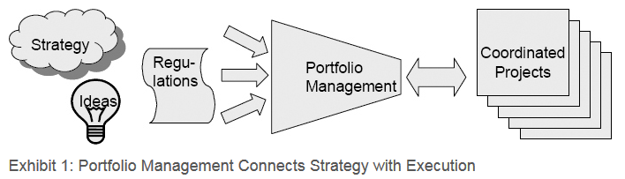
Project Portfolio Management (PPfM)
The Business Problem
Nearly all organizations have more project work to do than people and money to do the work. Often the management team has difficulty saying “no.” Instead, they try to do everything by cramming more work onto the calendars of already overworked project teams .
Despite a heavy investment of people and money in projects, the organization still gets poor results because people are working on the wrong projects or on too many projects. Trying to do too much causes all projects to suffer from delays, cost overruns, or poor quality.
The Solution
Effective project organizations focus their limited resources on the best projects, declining to do projects that are good but not good enough. PPfM enables them to make and implement these tough project selection decisions.
PPfM is a funnel that connects strategic planning to the execution of projects, making the strategic objectives executable. Exhibit 1 shows the PPfM funnel.

Slide 14
Project Portfolio Management (PPfM)
Project portfolio management (PPfM) is fundamentally different from project and program management. Project and program management are about execution and delivery---doing projects right. In contrast, PPfM focuses on doing the right projects at the right time by selecting and managing projects as a portfolio of investments. It requires completely different techniques and perspectives.
Good portfolio management increases business value by aligning projects with an organization’s strategic direction, making the best use of limited resources, and building synergies between projects.
Project Management | Do projects right.
Program Management | Do Projects together
Portfolio Management | Do the right projects
Notes:
Resource Constraints
Problem: Limited resources—such as budget, personnel, and time—make it challenging to support all projects in a portfolio adequately. Over-allocation can lead to burnout, delays, and reduced project quality.
Impact: Critical projects may suffer, or resource bottlenecks can lead to conflicts and delays, affecting the entire portfolio’s success.+
Problem: Balancing immediate, short-term projects with long-term, strategic initiatives can be challenging, especially when short-term demands compete for the same resources.
Impact: Short-term projects may overshadow important long-term initiatives, reducing the portfolio’s ability to deliver sustainable value.

Slide 15
Technical Assessment
Technical Assessment of a proposed system consists of evaluation whether the required functionality can be achieved with current affordable technologies. Organizational policy, aimed at providing a consistent software/hardware infrastructure, is likely to limit the technical solutions considered. The cost of the technology adopted must be taken into account in the cost benefit analysis.
Limitations:
Nature of solution produced by strategic information system plan.
Cost of solution . Hence undergo cost benefit analysis.

Slide 16
Economic Assessment – Why?
Consider whether the project is the best among other options
Prioritise the projects so that the resources can be allocated effectively if several projects are underway
Note: A common way is to compare the expected costs of development and operation of the system with the benefits of having it in production
Economic Assessment – How
Cost-benefit analysis
Cash flow forecasting
Various cost-benefit evaluation techniques
Net Profit, Payback Period, ROI ,NPV and IRR
Cost-benefit analysis is to compare the estimated costs of development and operation of a system with the estimated benefits of putting the system in place.
Why need Cash flow forecasting? It is because the excess of benefits over costs is not sufficient to justify the implementation of a proposed project.
Notes:
Benefits can be:
Quantified and valued e.g. a reduction of x staff saving £y
Quantified but not valued e.g. a decrease in customer complaints by x%
Identified but not easily quantified – e.g. public approval for a organization in the locality where it is based

Slide 17
Economic Assessment – Cost Benefit Analysis
Costs
Development costs : Salaries and employment costs, Hardware/Software Platform cost
Setup costs : Staff training, New Hardware, ancillary equipment, Data base conversion
Operational costs: Support Cost, Hosting cost, Licensing cost, Maintenance/Backup Cost
Benefits
Benefits are quite difficult to quantify in monetary terms even if they are identified.
Direct benefits: are those accrue directly from the operation of the system.
Examples:
Reduction of staff employment
Re-organization of staff
Assessable indirect: benefits are the secondary benefits.
Example:
Increase of accuracy through a more user-friendly screen
Intangible benefits: relate to those benefits that are longer term in nature or those benefits that are considered very difficult to quantify.
Example:
Enhanced job interest → lower recruitment costs
Notes:
Benefits might include:
Mandatory requirement: You could argue that as you have to comply with a mandatory requirement, the question of benefits is irrelevant in this case. However as failure to comply will a negative outcome (e.g. not being able to trade), avoiding that negative outcome is clearly a benefit which could be costed.
Improved quality of service
Increased productivity
More motivated workforce
Internal management benefits: ‘Internal management benefits’ includes things like better decision-making. In the case of an insurance company a deeper analysis of insurance claims might help identify types of business that are most risky and allow the company to adjust premiums to cover these.
Risk reduction
Economies: ‘Economies’ refers to cost-cutting e.g. using an automated telephone system to direct calls without human intervention could allow an organization to reduce staff.
Revenue enhancement/acceleration e.g. the sooner that bills reach the customers, the sooner they can pay them.
Strategic fit: ‘Strategic fit’ A change might not benefit any single group within an organization but might have to be made to obtain a benefit for the organization as a whole.

Slide 18
EA– Cash Flow Forecasting
What?
Estimation of the cash flow over time
Why?
An excess of estimated benefits over the estimated costs is not sufficient
Need detailed estimation of benefits and costs versus time
Income
Time
Expenditure
Need to spend money at first (e.g. staff salary, employment cost, hardware and software costs) no matter where the money comes from. e.g. resources from company, or money from the bank. If the money is from bank, you need to calculate the interest as well.

Slide 19
EA– Cash Flow Forecasting
Example of Cashflow Forecast
Year Project 1 Project 2 |  |  |  | Project 3 | Project 4
0 |  | -100,000 | -1,000,000 | -100,000 | -120,000
1 |  | 10,000 | 200,000 | 30,000 | 30,000
2 |  | 10,000 | 200,000 | 30,000 | 30,000
3 |  | 10,000 | 200,000 | 30,000 | 30,000
4 |  | 20,000 | 200,000 | 30,000 | 30,000
5 |  | 100,000 | 300,000 | 30,000 | 75,000
Net | Profit | 50,000 | 100,000 | 50,000 | 75,000
Problem with Cashflow Forecasting
Need to forecast the expenditure and the income
Accurate forecast is not easy
Need to revise the forecast from time to time
Table 1

Slide 20
Net profit
Year | Cash-flow
0 | -100,000
1 | 10,000
2 | 10,000
3 | 10,000
4 | 20,000
5 | 100,000
Net profit | 50,000
‘Year 0’ represents all the costs before system is operation
‘Cash-flow’ is value of income less outgoing
Net profit value of all the cash-flows for the lifetime of the application

Slide 21
Pay back period
This is the time it takes to start generating a surplus of income over outgoings. What would it be below?
Year | Cash-flow | Accumulated
0 | -100,000 | -100,000
1 | 10,000 | -90,000
2 | 10,000 | -80,000
3 | 10,000 | -70,000
4 | 20,000 | -50,000
5 | 100,000 | 50,000
Payback Period = 4.5 years
Notes:
The payback period would be about 4.5 years.

Slide 22
Return on investment (ROI)
ROI =
Average annual profit
Total investment
X 100
In the previous example
average annual profit = 50,000/5 = 10,000
ROI = 10,000/100,000 X 100 = 10%

Slide 23
Cost Benefit Evaluation Techniques
Technique | Advantages | Disadvantages
Net Profit | Simple to Use | -Does not show profit relative to size of investment -Ignores the Timing of cash flow
Payback Period | -Simple to calculate, not particular sensitive to small forecasting errors. -Give some idea of cashflow impact | -Ignores any income (or expenditure) after the payback period. -Ignores overall profitability of project
Return on Investment (ROI) | simple and easy to calculate, quite popular | -Ignores the timing of the cash flow. -Potentially very misleading because rate of return bears no relationship with the current interest rates
Notes:
Net profit = Total income – Total costs
Payback period = Time taken to break even or payback initial investment
Return on Investment (ROI): Compares Net profitability to Investment required.

Slide 24
Net present value
Would you rather I gave you £100 today or in 12 months time?
If I gave you £100 now you could put it in savings account and get interest on it.
If the interest rate was 10% how much would I have to invest now to get £100 in a year’s time?
This figure is the net present value of £100 in one year’s time
Notes:
If you invested £91 now you would get £9.10 in interest which would give you £100.10 in 12 months

Slide 25
Cost Benefit Evaluation Techniques - NPV
Net present value (NPV)
It is the sum of the present values of all future amounts.
Present value is the value which a future amount is worth at present
It takes into account the profitability of a project and the timing of the cash flows
Sum of all incoming/outgoing payments , discounted using an interest rate, to a fixed point in time (the present)
Discount rate is the annual rate by which we discount future earning
e.g. We could invest $100 in a bank today & have $100 plus interest in a years time. If we say value of $100 in a years time is $91, means $100 in a years time is equal to $91 now.
The equivalence of $91 now and $100 in a year means we are discounting future income by approx. 10%. The rate by which we discount future earning is called discount rate.

Slide 26

Cost Benefit Evaluation Techniques - NPV
Let n be the number of year and r be the discount rate, the present value (PV) is given by
is know as discount factor
- In case of 10% discount rate and one year
-Discount factor = 1/(1+0.10) = 0.9091
- In case of 10% discount rate and two years
-Discount factor = 1/(1.10 * 1.10) = 0.8294

Slide 27
Cost Benefit Evaluation Techniques - NPV
Year | Cashflow Project 1 | Cashflow Project 2 | Discount Factor (10%) PV = 1/(1+r)^{n} | Discounted Cashflow Project 1 (cash flow * discount factor) | Discounted Cashflow Project 2
0 | -100,000 | -100,000 | 1 | -100,000 | -100,000
1 | 10,000 | 30,000 | 0.9091 | 9091 | 27273
2 | 10,000 | 30,000 | 0.8264 | 8264 | 24792
3 | 10,000 | 30,000 | 0.7513 | 7513 | 22539
4 | 20,000 | 30,000 | 0.683 | 13,660 | 20490
5 | 100,000 | 30,000 | 0.6209 | 62,090 | 18627
Net profit | 50,000 | 50,000
NPV |  |  |  | 618 | 13,721
Though Project 1 and 2 have same initial investment and net profits but significant different in NPV value. This difference in NPV reflects, we must wait longer for the bulk of income.
Technique | Advantages | Disadvantages
Net Present Value | -Takes into account the profitability. -Consider the timings of payments. -Consider economic situation through discount rate. | -Hard to select an appropriate discount rate. -May not be directly comparable with earnings from other investments or the costs of borrowing capital
Notes:
NPV is the sum of the discounted cash flows for all the years of the ‘project’ (note that in NPV terms the lifetime of the completed application is included in the ‘project’)
The figure of £618 means that £618 more would be made than if the money were simply invested at 10%. An NPV of £0 would be the same amount of profit would be generated as investing at 10%.

Slide 28
Internal rate of return
Internal rate of return (IRR) is the discount rate that would produce an NPV of 0 for the project
Can be used to compare different investment opportunities ( bank, rebort system, gold, mutual fund etc)
There is a Microsoft Excel function which can be used to calculate
Notes:
The Excel function in question is =IRR.

Slide 29
Dealing with uncertainty: Risk evaluation
project A might appear to give a better return than B but could be riskier
Could draw up draw a project risk matrix for each project to assess risks – see next overhead
For riskier projects could use higher discount rates

Slide 30
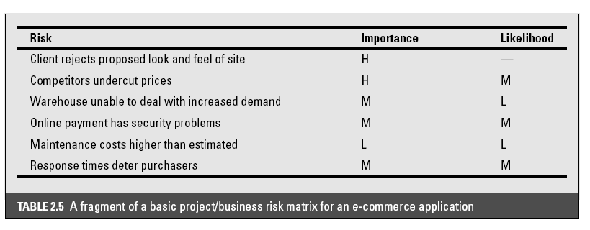
Example of a project risk matrix
Notes:
In the table ‘Importance’ relates to the cost of the damage if the risk were to materialize and ‘likelihood’ to the probability that the risk will actual occur. ‘H’ indicates ‘High’, ‘M’ indicates ‘medium’ and ‘L’ indicates ‘low’. The issues of risk analysis are explored in much more depth in lecture/chapter 7.

Slide 31
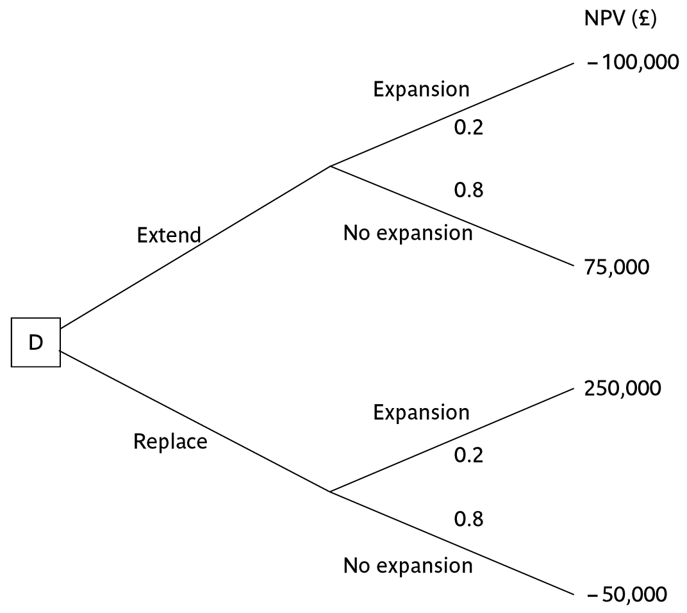
Decision trees
Notes:
The diagram here is figure 2.2 in the text.
This illustrates a scenario that could relate to the IOE case study. Say Amanda is responsible for extending the invoicing system. An alternative would be to replace the whole of the system. The decision is influenced by the likelihood of IOE expanding their market. There is a strong rumour that they could benefit from their main competitor going out of business: in this case they could pick up a huge amount of new business, but the invoicing system could not cope. However replacing the system immediately would mean other important projects would have to be delayed.
The NPV of extending the invoicing system is assessed as £75,000 if there is no sudden expansion. If there were a sudden expansion then there would be a loss of £100,000. If the whole system were replaced and there was a large expansion there would be a NPV of £250,000 due to the benefits of being able to handle increased sales. If sales did not increase then the NPV would be -£50,000.
The decision tree shows these possible outcomes and also shows the estimated probability of each outcome.
The value of each outcome is the NPV multiplied by the probability of its occurring. The value of a path that springs from a particular decision is the sum of the values of the possible outcomes from that decision. If it is decided to extend the system the sum of the values of the outcomes is £40,000 (75,000 x 0.8 – 100,000 x 0.2) while for replacement it would be £10,000 (250,000 x 0.2 – 50,000 x 0.80). Extending the system therefore seems to be the best bet (but it is still a bet!).

